Slide 1
Exploring Categorical Data

Slide 2


























What is Categorical Data?
Date | Sports | T-shirt size | Prize of T-shirt | Weather
5th June | Cricket | S | 200 | Sunny
9th June | Football | M | 300 | Cloudy
11th June | Tennis | S | 200 | Rainy
13th June | Relay | L | 400 | Windy

Slide 3
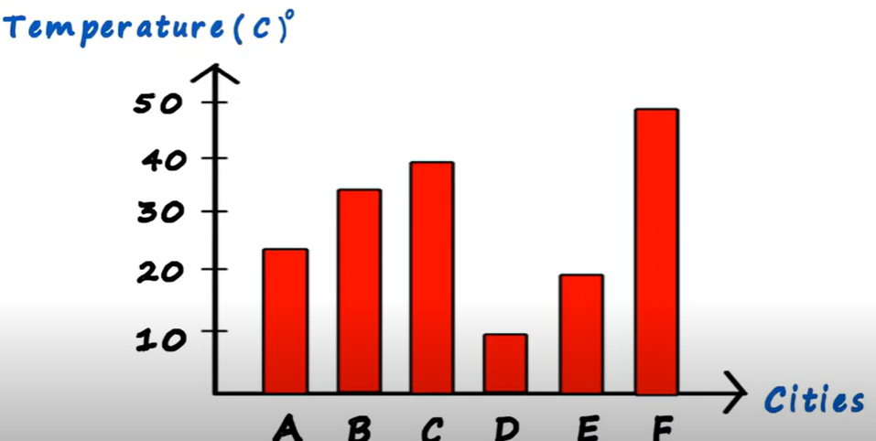























Bar Graph

Slide 4
Expected Value
When the categories can be associated with a numeric value, this gives an average value based on a category’s probability of occurrence.

Slide 5











































Example

Slide 6
Example

Slide 7
Correlation
Correlation is relation between two variables.
When X increases then Y also increases – positive correlation
When X decreases then Y also decreases – negative correlation
When X increases and Y decreases – No correlation

Slide 8






























ScatterPlot

Slide 9
Positive Correlation, Negative Correlation and No Correlation

